Slide 1
Cataloguing Artworks in MoMA
By Anya Ellis

Slide 2
Introduction
Cataloguing artwork is a huge task that consist of:
figuring out an artwork’s provenance,
condition,
handling requirement,
and more.
Museum of Modern Art (MoMA) is a world renowned
Has over 200,000 artworks
Has the info of over 90,000 artworks online
Notes:
Cataloguing artwork is a huge task that consist of: figuring out an artwork’s provenance, condition, handling requirement, and more. It is essential for risk management and exhibition development.
Museum of Modern Art (MoMA) is a world renowned museum with over 200,000 artworks, and with this size, it make sense that a portion of its collection is not catalogue. But, we have to ask ourselves which portion? And is there a trend?
This bring us to our problem

Slide 3
Problem Statement
Goal: To create a model that not only predicts whether an artwork is catalogued or not, but also identify attributes that have the most effect.
Importance:
It gives artist knowledge on which attributes are normal for museum acquisitions
It allows the museum to see if they have issues cataloguing certain types of works
This could be generalized to other museums outside of the MoMA

Slide 4
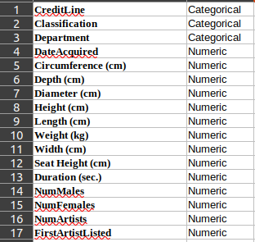
Data
Over 90,000 artworks in database
29 Attributes
12 Numeric Types
17 String Types
We use 17 of them
String Types turned into categorical int data

Slide 5
Analysis & Modeling
Model | Accuracy
NB, F1 | 39%
NB, F2 | 39%
NB, F3 | 39%
LogR, F1 | 64%
LogR, F2 | 64%
LogR, F3 | 64%
3 Fold Cross Verification
Began with Naive Bayes Analysis
Cons: It had a very low accuracy
Pros: During process, learned variance & mean of attributes
Moved on to Logistic Regression
Cons: Accuracy is not above 80%
Pros: Can use weights to showcase which attributes have the most effect

Slide 6
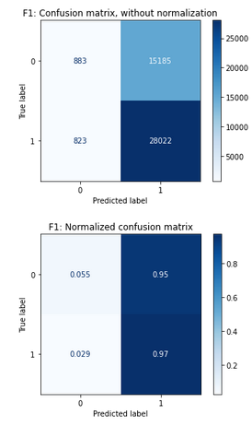
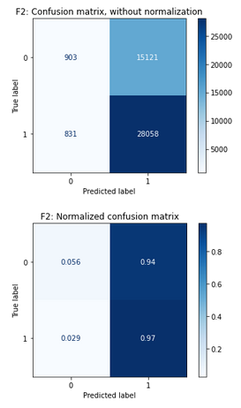
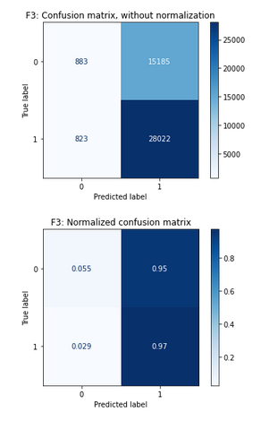
Confusion Matrix, based on LogR

Slide 7
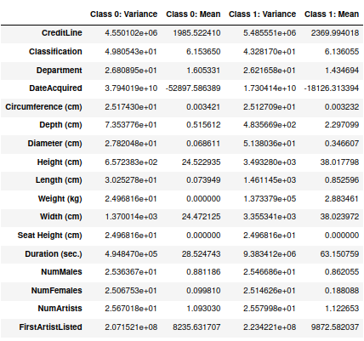
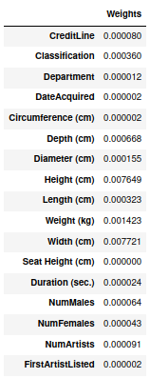
Attributable Info
Notes:
Interesting insight, the mean & variance for the duration of a film is strikingly different between the classes.
Not Catalogued:
Var: 4.98e+05
Mean: 28.52
Catalogued:
Var: 9.38e+06
Mean: 63.15
The classification of the artwork (ie painting, sculpture, etc) had 3x more effect than the Department (ie “Painting & Sculpture”, “Film”, etc)
Out of the dimensionality attributes, height & width have the most effect
The number of male artists has more of an effect than the number of females
Which could just be related to the overwhelming number of male artists in the collection

Slide 8
Results & Conclusions
Out of the dimensionality attributes, height & width have the most effect
The classification of the artwork (ie painting, sculpture, etc) had 3x more effect than the Department (ie “Painting & Sculpture”, “Film”, etc)
The number of male artists has more of an effect than the number of females
Which could just be related to the overwhelming number of male artists in the collection
Interesting insight, the mean & variance for the duration of a film is strikingly different between the classes.
Not Catalogued:
Var: 4.98e+05
Mean: 28.52
Catalogued:
Var: 9.38e+06
Mean: 63.15

Slide 9
Future Work
Raise the prediction accuracy to above 80%
Some unique created attributes were left out due to time constraints of the project, such as
Medium as bit
TimeFinished
TimeStarted
Add the attributes related to artist bio, & better tracking of artist IDs

